Slide 1
Chapter 4
Types of chemical reactions and solution stoichiometry

Slide 2
Aqueous Chemistry
Virtually all chemistry that makes life possible occurs in solution
Common tests for sugar, cholesterol, and iron are all done in solution.

Slide 3
Aqueous Solution
Solvent: dissolving medium
Solute: what is being dissolved
Aqueous Solution: When water is the dissolving medium
Electrolytes: substance that dissolves in water to yield a solution that conducts electricity.

Slide 4
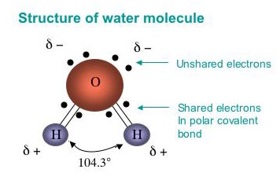
Water as a Solvent 4.1
One of the properties of water is its ability to dissolve MANY different substances.
Polar: unequal distribution of charges makes water polar, allowing it to dissolve solutes.

Slide 5
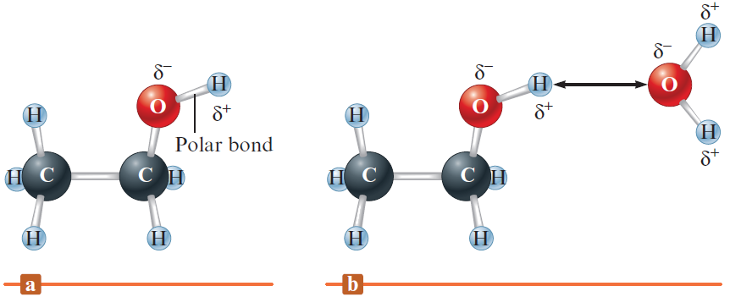
Solubility of Ethanol in Water
The ethanol molecule contains a polar O—H bond similar to those in the water molecule
The polar water molecule interacts strongly with the polar O—H bond in ethanol

Slide 6
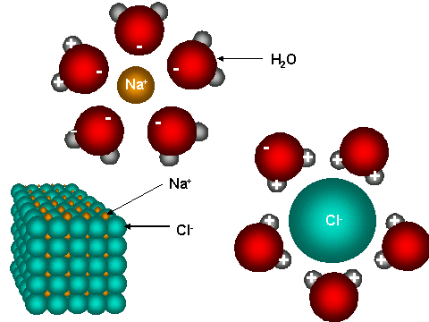
Ions dissolving in water
Ionic substances such as salts dissolve in water to release (+) and anions (-).
Ex: NaCl -> Na⁺ , Cl⁻
This is process is called hydration.

Slide 7
Solubility
The amount of a substance that dissolves in a given volume of solvent at a given temperature.
If ionic compounds are not greatly attracted to the ions in water then that compound will be less soluble in water.

Slide 8
What is not soluble in water?
Like dissolves like
Substances with similar intermolecular forces of attraction will tend to be soluble (or miscible) in one another. Polar/polar or nonpolar/nonpolar
In general polar and ionic substances are expected to be more soluble in water than nonpolar substances.

Slide 9
Substances with similar intermolecular forces of attraction will tend to be soluble (or miscible) in one another. Polar/polar or nonpolar/nonpolar

Slide 10
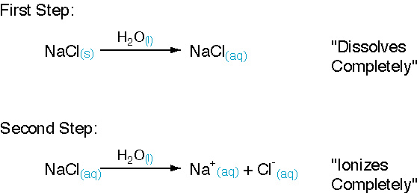
Strong and Weak electrolytes 4.2
Strong electrolyte: ionize completely in water (single arrow). Are efficient conductors of electricity
Ex: Strong acids, strong bases, and soluble salts.

Slide 11
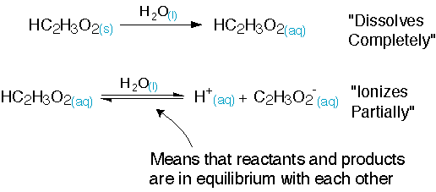
Weak Electrolytes
Ionize partially in water (double arrows). Poor conductors of electricity
Ex: weak acids (acetic acid shown), weak bases, partially soluble salts.

Slide 12
Non-electrolytes
Do not IONIZE in water or conduct electricity. They are covalent compounds that are not acids or bases.
The can dissolve in water (ex: sugar) but they do not form ions.

Slide 13
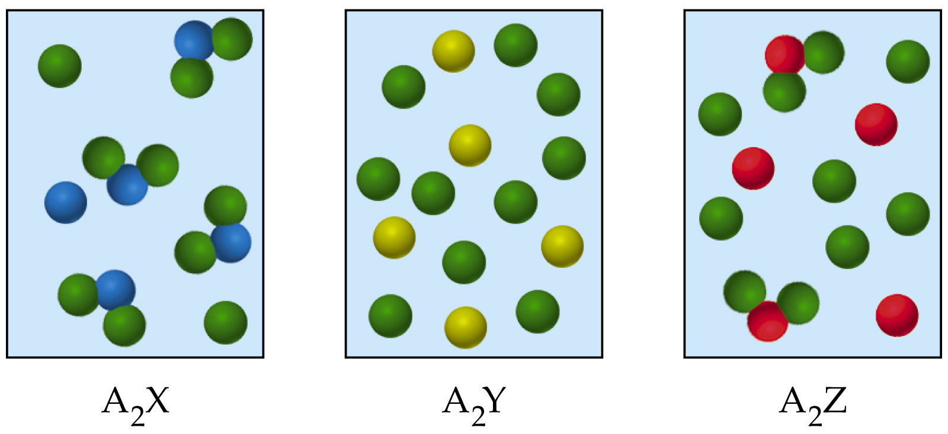
Identify the strong and weak electrolytes.

Slide 14
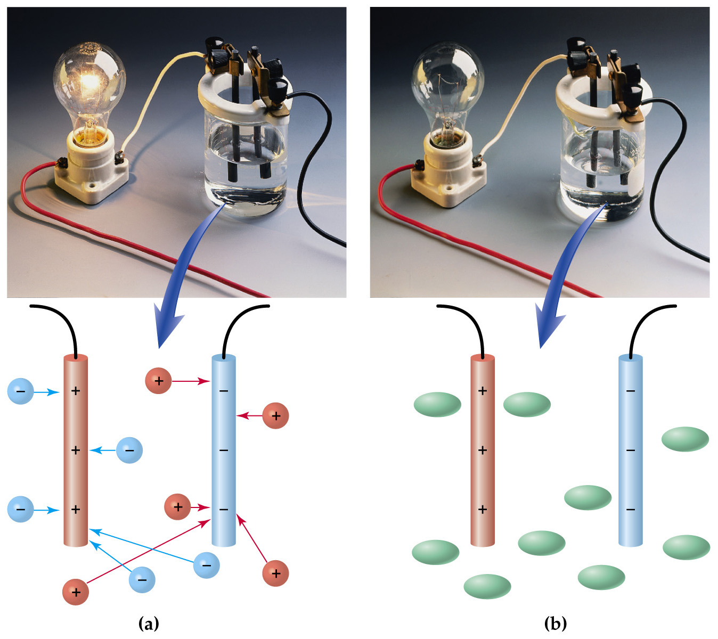
A simple device to demonstrate the electrical conductivity of an ionic solution.
(a) A solution of NaCl conducts electricity because of the movement of charged particles (ions), thereby completing the circuit and allowing the bulb to light.
(b) A solution of sucrose does not conduct electricity or complete the circuit because it has no charged particles. The bulb therefore remains dark.

Slide 15
Acids
Substances that are able to donate a hydrogen ion (H⁺) and increase [H⁺] in aqueous solutions.
Strong Acids to Memorize:
HNO₃, H₂SO₄, HClO₄, HClO₃, HCl, HBr, HI

Slide 16
Bases
Are soluble ionic compounds containing hydroxide ion (OH⁻). When dissolved in water the cations and OH⁻ ions separate and move independently.
Strong Bases to Memorize:
hydroxides of group 1A, heavy elements of group 2A: Ca(OH)₂, Sr(OH)₂, Ba(OH)₂.

Slide 17
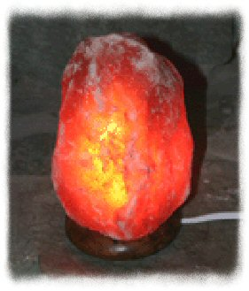
Salts
Another name for an ionic compound. When a salt dissolves in water, it breaks up into its ions, which move about independently.
Hand crafted Himalayan Salt Lamps bring beauty, harmony and health into your living and working space.

Slide 18
Composition of Solutions 4.3
A solution is a homogeneous mixture of two or more substances. One of these substances is a solvent the other is the solute.
Solvent: component in greater quantity
Solute: component in lesser quantity.
Solution = solvent + solute
Concentration: amount of solute dissolved in a given amount of solution. Units vary.

Slide 19
Molarity (M)
Number of moles of solute in one liter of solution
Molarity = moles of solute
liter of solution
Units = mol/L = M

Slide 20
Question
Calculate the molarity of a solution made by dissolving 5.00g of C₆H₁₂O₆ (MW = 180 amu) in sufficient water to form 100 ml solution.

Slide 21
Answer
5.0 g 1mol = 0.027 mol
180g
M = 0.027 = 0.27M
0.1

Slide 22
Question
How many grams of Na₂SO₄ are there in 5ml of 0.50 M Na₂SO_{4.}

Slide 23
Answer
0.5 M = X = 0.0025 mol
0.005
0.0025 mol 142 g Na₂SO₄ = 0.355 g Na₂SO₄
1 mol

Slide 24
Question
0..50 M = 0.035 mol = 0.07 L
x L
0.07 L 1000ml = 70ml
1L

Slide 25
Question
Which of the following solutions of strong electrolytes contains the largest concentration of chloride ions
A.0.30 M AlCl₃
B. 0.60M MgCl₂
C. 0.40 NaCl

Slide 26
Answer
0.30(3 Cl) = 0.90 M Cl
0.60 (2Cl) = 1.2 M Cl
0.40 ( 1 Cl) = 0.4 M Cl
MgCl₂ > AlCl₃ > NaCl

Slide 27
Dilutions
Moles before dilution = moles after dilution
M₁V₁ = M₂V₂
How many milliliters of 5.0 M K₂Cr₂O₇ solution must be diluted in order to prepare a 250 mL of 0.10M solution.

Slide 28
Answer
250 mL = .250 L
5.0 ( V₁) = (0.10) 0.250
V₁ = .005 L

Slide 29
Homework Sections
Page 180
Sec 4.1 - 4.3
#’s 11, 13, 15, 17, 20, 21, 23, 25, 28

Slide 30
4.5 Precipitate Reactions
When two solutions are mixed, an insoluble substance sometimes forms.
Precipitate: in soluble substance.
Wkb ch 9/10

Slide 31
Goal
Use solubility rules to predict whether a precipitate will form when electrolytic solutions are mixed.
Hint: find products that have insoluble salt(s). This implies a precipitate reaction.

Slide 32
Figure 4.15 - The Reaction of Aqueous Potassium Chromate and Barium Nitrate

Slide 33
Solubility Rules (memorize) also on pg 48 of wkb.
Solubility Rules (memorize)
1. NH₄⁺ and alkali metal (group IA) salts are soluble.
2. Nitrate, NO₃⁻, acetate C₂H₃O₂⁻, chlorate, ClO₃⁻, perchlorate ClO₄⁻, salts are soluble.
3. Chloride, Cl⁻, bromide, Br⁻,iodide, I⁻, salts are soluble.
EXCEPT: Ag⁺, Hg₂²⁺, Pb²+ (AgBr, Hg₂I₂, PbCl₂)
4. Sulfate, SO₄²⁻ , salts are soluble.
EXCEPT: PbSO₄, HgSO₄, CaSO₄, BaSO₄, AgSO₄, SrSO₄
5. Most Hydroxide, OH- ,salts are insoluble.
Hydroxide salts of Group I elements are soluble (Li, Na, K, Rb, Cs, Fr).
Hydroxide salts of Group II elements (Ca, Sr, and Ba) are slightly soluble.
Hydroxide salts of transition metals and Al³⁺ are insoluble. Thus, Fe(OH)₃, Al(OH)₃, Co(OH)₂ are not soluble.

Slide 34
Formation of gases
Common gases formed in double replacement (metathesis) rxns are shown in the table (next slide) these reactions WILL appear pn the AP test! SO memorize these 4 gases!

Slide 35
H₂S | Any sulfide salt (s²⁻) plus an acid form: H₂S + salt
CO₂ | Any carbonate (CO₃²⁻) + acid form: CO₂ + HOH + salt
SO₂ | Any sulfite (SO₃²⁻) + acid form: SO₂ + HOH + salt
NH₃ | Any ammonium salt (NH₄⁺ + any soluble strong hydroxide react with heating to form: NH₃ +HOH + salt

Slide 36
Example
Predict what will happen when the following pairs of solutions are mixed. (Hint: break it into ions)
KNO_{3(aq)} and BaCl_{2 (aq)}
Na₂SO_{4(aq)} and Pb(NO₃)_{2(aq)}

Slide 37
Answer
KNO_{3(aq)} and BaCl_{2 (aq)}
Reactants: K⁺ + NO₃⁻ + Ba²⁺ + Cl^{- →}
Products: KCl + Ba(NO₃)₂
Both are soluble according to the rules and thus no precipitate forms.
Rule #1 Rule # 2

Slide 38
Na₂SO_{4(aq)} and Pb(NO₃)_{2(aq)}
Reactants: Na⁺ + SO₄²⁻ + Pb²⁺ + NO₃^{- →}
Products: NaNO₃ + PbSO₄
NaNO₃ Soluble according to rule #1.
PbSO₄ Insoluble according to rule # 4

Slide 39
4.6 Describing reactions
In this section we will talk about the types of equations used to represent reactions in solution.
Three types of equations:
Molecular
Complete ion
Net ionic

Slide 40
Molecular Equations
Shows the complete chemical formula for reactants and products
HCl_{(aq)} + NaOH_{(aq)} → NaCl_{(aq)} + H₂O_{(l)}
Strong acid Strong Base Soluble Salt nonelectrolite
Strong elect. Strong elect.

Slide 41
Complete Ionic Equation
Shows the formula of cations and anions for ionic compounds.
H⁺_{(aq)} + Cl⁻_{(aq)} + Na⁺_{(aq)} + OH⁻_{(aq)} → Na⁺_{(aq)} + Cl⁻_{(aq)} + H₂O_{(l)}

Slide 42
Net Ionic Equation
Includes only those solutions components directly involved in the reaction.
H⁺_{(aq)} + OH⁻_{(aq)} → H₂O_{(l)}
Spectator ions: ions that appear in identical forms in reactants and product side of a chemical rxn that do not participate in the rxn directly.
Liquids (l) never break up.
Solids on the reactant side can dissolve and form reactants
Solids on product side are precipitates and don’t break up
NOTE: The net ionic equation of any strong acid-base neutralization rxn is always like the above rxn.

Slide 43
What to do with subscripts
MOLECULAR: Mg(ClO₄)_{2(aq)}
NET IONIC: Mg²⁺ 2ClO₄ ⁻_{(aq)}

Slide 44
Write the three types of equations for the following rxn.
HClO_{4(aq)} + Mg(OH)_{2(s)} →

Slide 45
Molecular
2HClO_{4(aq)} + Mg(OH)_{2 (s)} → Mg(ClO₄)_{2(aq)} + 2H₂O
Complete Ionic
2H⁺ + 2ClO₄⁻ + Mg²⁺ + 2OH⁻ → Mg²⁺ + 2(ClO₄) + 2H₂O
Note subscripts that are “multiplied” through become coefficients
Coefficients apply to all atoms in a compound
Net Ionic
2H⁺ + 2OH⁻ → 2H₂O

Slide 46
Write the three types of equations for the following rxn.
Pb(NO₃)₂ (aq) + 2KI (aq) →

Slide 47
Molecular
Pb(NO₃)₂ (aq) + 2KI (aq) → PbI₂ (s) + 2KNO₃ (aq)
Complete Ionic
Pb ²⁺ (aq) + 2NO₃⁻¹ (aq) + 2K⁺ (aq) + 2I⁻ (aq)→ PbI₂ (s) + 2K⁺ (aq) + 2NO₃⁻ (aq)
Note subscripts that a re “multiplied” through become coefficients
Coefficients apply to all atoms in a compound
Net Ionic
Pb ²⁺ (aq) + 2I⁻ (aq) → PbI₂ (s)

Slide 48
Write the net ionic equation for the reaction of silver
nitrate with sodium chloride.
AgNO3 (aq) + NaCl (aq) AgCl (s) + NaNO3 (aq)
Ag⁺ + NO3⁻ + Na⁺ + Cl⁻ AgCl (s) + Na⁺ + NO3⁻
Ag⁺ + Cl⁻ AgCl (s)
4.2

Slide 49
Homework Sections
4.5-4.6
Pg 181
#’s
29, 30, 31, 33, 34, 36

Slide 50
4.7 Stoichiometry of precipitation reactions
2 differences
its hard to predict products in solution, so we need remember the rules.
To obtain moles of reactants we must use the volume of the solution and its molarity.

Slide 51
Example:
What is the mass of NaCl solid that must be added to 1.50 L of a 0.100 M AgNO₃ solution to precipitate all the Ag⁺ ions in the form of AgCl?

Slide 52
Reactants : Ag⁺ + NO₃⁻ + Na⁺ + Cl⁻
All are soluble Rule # 1 and 2
Products: AgCl + NaNO₃
NaNO₃ is soluble (rule 1) AgCl is insoluble (rule 3)
Forming a solid.
SO…
Lets add enough Cl⁻ ions to react with all the Ag⁺ to form a precipitate of Ag out of the solution in the form of AgCl.

Slide 53
Given:
1.50L
0.100M AgNO₃ thus 0.100M Ag and 0.100M NO₃
1.5 L AgNO₃ 0.100 mol Ag⁺ = 0.150 mol Ag⁺ in 1.5L
1L AgNO₃
Because Ag⁺ and Cl⁻ react in a 1:1 ratio 0.150 mol
Cl⁻ ions are need and thus 0.150 mol NaCl are needed. But we need to know grams not moles.
0.150 mol NaCl 58.45g NaCl = 8.77g NaCl
1 mol NaCl

Slide 54
Question
When aqueous solutions of Na₂SO₄ and Pb(NO₃)₂ are mixed, PbSO₄ precipitates. Calculate the mass of PbSO₄ formed when 1.25 L of 0.0500 M Pb(NO₃)₂ and 2.00L of 0.0250 M Na₂SO₄ are mixed?

Slide 55
Step 1:
Write a balanced equation
Pb²⁺_{(aq)} + SO₄²⁻_{(aq)} → PbSO_{4 (s)}

Slide 56
Step 2:
Find limiting reactant since we only have so much reactant to work with.
Pb²⁺_{(aq)} + SO₄²⁻_{(aq)} → PbSO_{4 (s)}
1.25 L 0.0500 mol Pb²⁺ 0.0625 mol Pb²⁺
1L
2.00 L 0.0250 mol SO₄²⁻ = 0.0500 mol SO₄²⁻
1 L

Slide 57
Step 3:
calculate moles of product.
0.0625 mol Pb²⁺ 0.0500 mol SO₄²⁻
Since Pb is in excess only 0.0500 mol of solid PbSO₄ will be formed. (since that is all of the sulfate we have available to us)

Slide 58
Step 4:
convert to grams of product:
The mass of PbSO₄ formed can be calculated using the molar mass of PbSO₄ (303.3g/mol)
0.0500 mol PbSO₄ 303.3g PbSO₄ = 15.2 gPbSO₄
1mol PbSO₄

Slide 59
4.8 Acid Base Rxn
Bronsted Lowery Acid:
Proton (H⁺) donor
Bronsted Lowery Base: Proton acceptor
(OH⁻) wants the proton.

Slide 60
Neutralization Rxn
When just enough base is added to react exactly with the acid in a solution, we can say the acid is neutralized.
Recall:
H⁺_{(aq)} + OH⁻_{(aq)} → H₂O_{(l)}
NOTE: The net ionic equation of any strong acid-base neutralization rxn is always like the above rxn.

Slide 61
Example:
What volume of 0.100 M HCl solution is needed to neutralize 25.0 ml of 0.350 M NaOH?
Step 1: list reactants
H⁺ + Cl⁻ + Na⁺ + OH⁻ →

Slide 62
Step 2:
What possible rxn’s will occur with our reactants:
H⁺ + Cl⁻ + Na⁺ + OH⁻
Na⁺ + Cl⁻ → NaCl (soluble both are spectator ions and do not participate directly in the reaction)
H⁺ + OH⁻ →H₂O (insoluble and will occur)

Slide 63
Step 3: write a balanced net ionic equation and calculate moles of reactant needed.
H⁺ + OH⁻ →H₂O
0.025 L NaOH 0.035 mol OH = 8.75 x 10⁻¹ mol OH⁻
1 L NaOH
We do not need to determine limiting reactant since the addition of H⁺ ions react exactly with the OH⁻ present in a1:1 ratio. Thus 8.75 x 10⁻¹ mol H⁺ is required to neutralize the solution.

Slide 64
Convert to volume required to neutralize the rxn.
Volume X 0.100 mol H⁺ = 8.75 x 10⁻¹ mol H⁺
1L
= 8.75 x 10⁻² L of .100M HCl is required to neutralize 25.0 mL of NaOH

Slide 65
Titrations
A procedure used for determining the concentration of an acid or a base in a solution by addition of a base or an acid of a known concentration.
We know the solution is at its “end point” (equivalence point) when the indicator changes color.

Slide 66
Figure 4.18 - Titration of an Acid with a Base

Slide 67
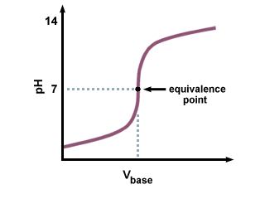
Equivalence point: the point in the titration when exactly enough base is added to neutralize the acid.

Slide 68
Indicators
Organic dyes that change color as they go from an acidic solution to basic solution.
When choosing an indicator consider if the equivalence point is with in the color change range.

Slide 69
Titration Question
What volume of 0.25M HNO₃ is required to titrate (neutralize) a solution containing 0.200 g of KOH.

Slide 70
KOH + HNO₃ → KNO₃ + H₂O
Grams to moles to moles to liters
0.2 g KOH 1 mol KOH x 1 mol HNO₃ x 1 L HNO₃ = 0.014 L HNO₃
56.1 g KOH 1 mol KOH 0.25 mol HNO₃

Slide 71
Interactive Example 4.14 - Neutralization Titration
A student carries out an experiment to standardize (determine the exact concentration of) a sodium hydroxide solution
To do this, the student weighs out a 1.3009-g sample of potassium hydrogen phthalate (KHC₈H₄O₄, often abbreviated KHP)
KHP (molar mass 204.22 g/mol) has one acidic hydrogen

Slide 72
Interactive Example 4.14 - Neutralization Titration (Continued)
The student dissolves the KHP in distilled water, adds phenolphthalein as an indicator, and titrates the resulting solution with the sodium hydroxide solution to the phenolphthalein endpoint
The difference between the final and initial buret readings indicates that 41.20 mL of the sodium hydroxide solution is required to react exactly with the 1.3009 g KHP
Calculate the concentration of the sodium hydroxide solution

Slide 73
Interactive Example 4.14 - Solution
Where are we going?
To find the concentration of NaOH solution
What do we know?
1.3009 g KHC₈H₄O₄ (KHP), molar mass (204.22 g/mol)
41.20 mL NaOH solution to neutralize KHP
The chemical reaction

Slide 74
Interactive Example 4.14 - Solution (Continued 1)
How do we get there?
What are the ions present in the combined solution?
K⁺ HC₈H₄O₄– Na⁺ OH–
What is the balanced net ionic equation for the reaction?

Slide 75
Interactive Example 4.14 - Solution (Continued 2)
What are the moles of KHP?
Which reactant is limiting?
This problem requires the addition of just enough OH– ions to react exactly with the KHP present
We do not need to be concerned with limiting reactant here

Slide 76
Interactive Example 4.14 - Solution (Continued 3)
What moles of OH– are required?
6.3701×10^{–3} mole of OH– is required to neutralize the KHP present
What is the molarity of the NaOH solution?

Slide 77
Homework
Ph 182
40,42,43,44

Slide 78
4.9 Oxidation –Reduction Precipitation
Rxn’s in which one or more electrons are transferred
Ex: 2 Na + Cl₂ → 2NaCl
neutral neutral Na⁺ Cl⁻

Slide 79
Photosynthesis is a redox rxn
Most energy production rxns are redox rxns. Such as combustion rxn (fuel)
Rusting of iron is a redox rxn
A LOT OF YOUR RESEARCH IS ABOUT REDOX RXNS!!!!

Slide 80
Oxidation States / numbers
A number identical with the valency but with a sign, expressing the nature of the charge of the species in question when formed from the neutral atom.
Of course there are exceptions, this is chemistry…hello!

Slide 81
The Rules
1. The rule is that the cation is written first in a formula, followed by the anion.
Example: in NaH, the H is H-; in HCl, the H is H+.
+ - + -
2. The oxidation number of a free element is always 0.
Example: The atoms in He and N₂, for example, have oxidation numbers of 0.
3. The oxidation number of a monatomic ion equals the charge of the ion.
Example: oxidation number of Na+ is +1; the oxidation number of N³⁻ is -3.
4. The oxidation number of oxygen in compounds is usually --2.

Slide 82
5. The oxidation number of a Group 1 element in a compound is +1.
6. The oxidation number of a Group 2 element in a compound is +2.
7. The oxidation number of a Group 3 element in a compound is +3.
8. The oxidation number of a Group 7 element in a compound is -1, except when that element is combined with one having a higher electronegativity.

Slide 83
9. The sum of the oxidation numbers of all of the atoms in a neutral compound is 0.
EX: CO2 = we know O = -2 and there are 2 O’s and CO2 is neutral so
C + 2(-2) = O
C = +4
10. The sum of the oxidation numbers in a polyatomic ion is equal to the charge of the ion.
EX: the sum of the oxidation numbers for SO4 2- is -2.
S + 4(-2) = - 2
S = +6

Slide 84
Assign Oxidation numbers for
CO₂
SF₆⁻
NO₃⁻

Slide 85
CO₂ C = +4 O= -2(2)
SF₆⁻ S = +5 F = -1(6)
NO₃⁻ N = +5 O = -2(3)
5+ -6 = -1

Slide 86
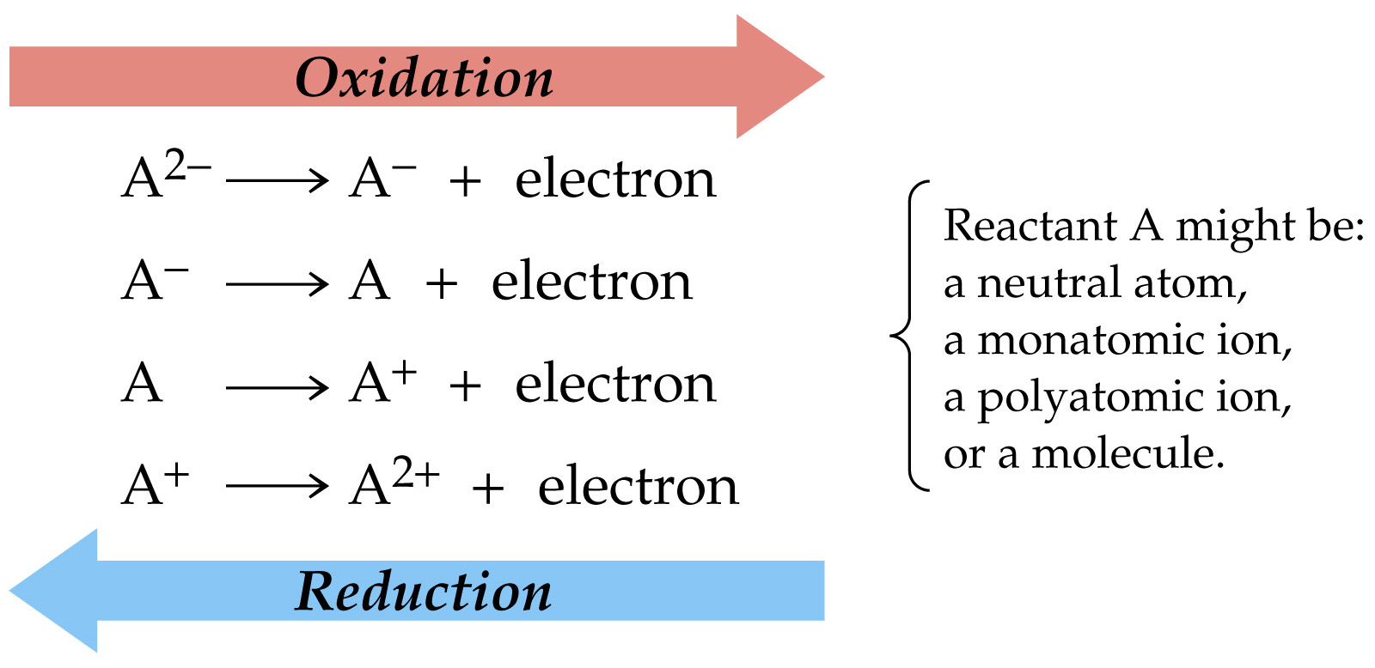
Leo the Lion Says Ger!!!

Slide 87
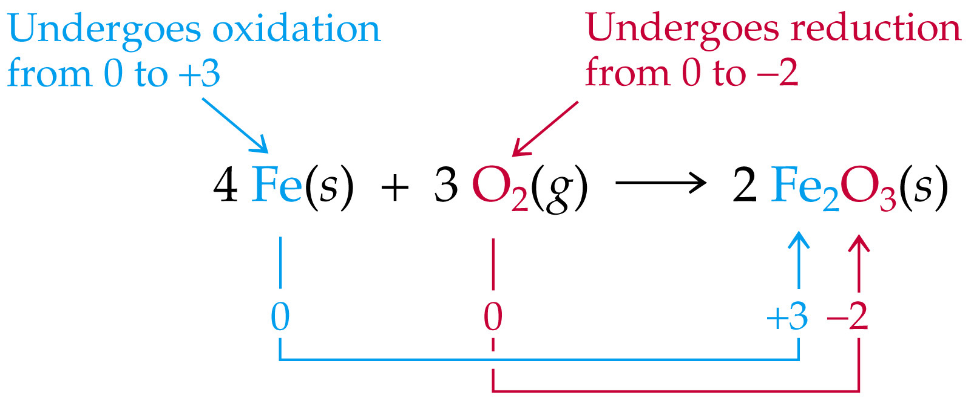
Fe = -3(2) = +6
O = -2(3) = -6
Oxidation for free elements is zero

Slide 88
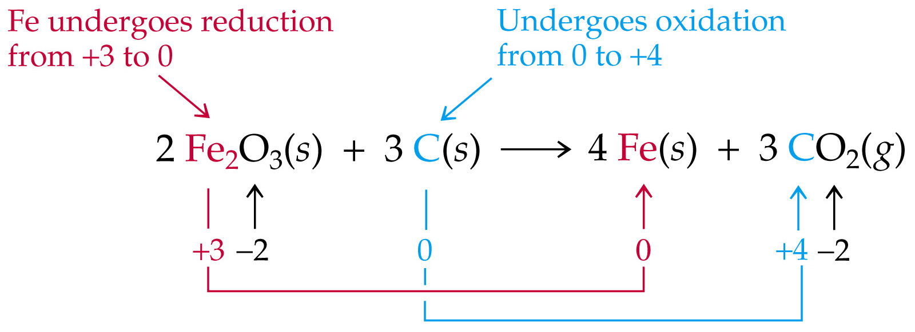
In this reaction, oxygen maintains a -2 oxidation number throughout.
Iron becomes reduced from +3 to 0 oxidation number, while carbon becomes oxidized from 0 to +4 state.
The species that becomes reduced is called the oxidizing agent since it is accepting electrons from some other species. Conversely, the species that becomes oxidized is called the reducing agent since it is giving up electrons.

Slide 90
Identify the atoms being oxidized and reduced as well as the oxidizing and reducing agents.
2Al + 3I₂ → 2AlI₃

Slide 91
2Al + 3I₂ → 2AlI₃
0 0 +3 -1
* Since each Al atom changes from a 0 → +3
Al is Oxidized
* Iodine is reduced 0 -1
* Al donates the electrons so it is the reducing agent
* I₂ accepts the electrons and it is the oxidizing agent

Slide 92
Homework
Pg 182
40,41,57, 58, 60, 61, 68, 65

